Slide 1

AutomateAds Analytics
Eddie Farah
Full Stack Software, Data Engineer.
^{AutomateAds.com}

Slide 2
Background
Advertisers have no way of knowing how their campaigns are going to perform until they actually run the campaign and start loosing money.
Advertisers have a problem trying to select the best target audience, campaign objective to run their campaigns against.
Some insights data but no predictive model available.
Trial and Error, User interaction and lots of manual configuration.

Slide 3
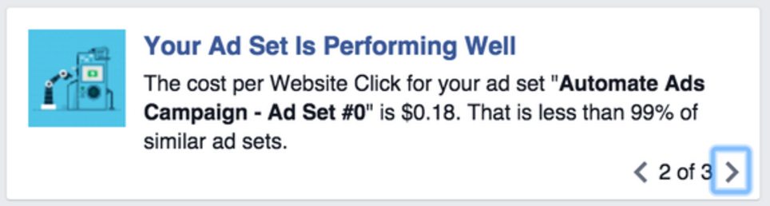
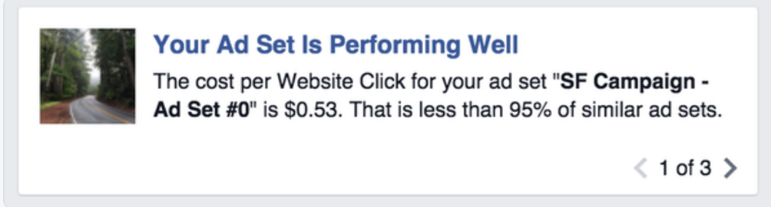
Suggested Solution
Predicting actual bid prices using
Campaign Historical Bid Estimation Data (Bid prices + reach estimates)
Actual Campaigns Insight data (Clicks, conversions, ..etc).
Help advertisers create better campaigns and predict campaign performance while creating the campaign and before they run the campaign
To suggest/predict better Campaign objective and bid strategies for advertisers when they create new campaigns.

Slide 4
Hypotheses
Historical Ads object (Campaign, Ad sets, Ads) data collected through the Facebook (Reach Estimate/Insights) APIs using 2 main Data sets:
Bids estimates
Performance statistics and customer usage data
Will help predicting actual new campaigns performance (Cost_per_conversion) at the creation level and to provide guidance to advertisers.

Slide 5
Data
Campaign Objective
Website_clicks
Website_conversions
mobile_install
Boost Post..etc)
Actual CTR - Click Through Rate (clicks / impressions)
Actual CPA (calculated = spent/conversions)
Actual CPC (calculated = spent / clicks)
Actual CPM (calculated)
Attribution Window Differences
Automation Data
BidType(Automated,CPC)
MaxBid
Bids Estimation Data
CPA (Cost Per Action) Bid Estimates (min,max,avg)
CPC (Cost Per Click) Bid Estimates (min,max,avg)
CPM (Cost per 1K Impressions)Bid Estimates (min,max,avg)
Reach Estimates
Actual Campaign Stats
Budget Spent
Clicks
Impressions
Conversions (mobile and web)

Slide 6

Data Sources
Data was gathered from 2 primary sources:
Facebook.com Ads API:
ReachEstimate API (/ReachEstimate)
Insights API (/Insights)
AutomateAds Automation Database- NoSQL MongoDB Collection to acquire:
Automation Type (Automated,cpc..etc) + MaxBId

Slide 7
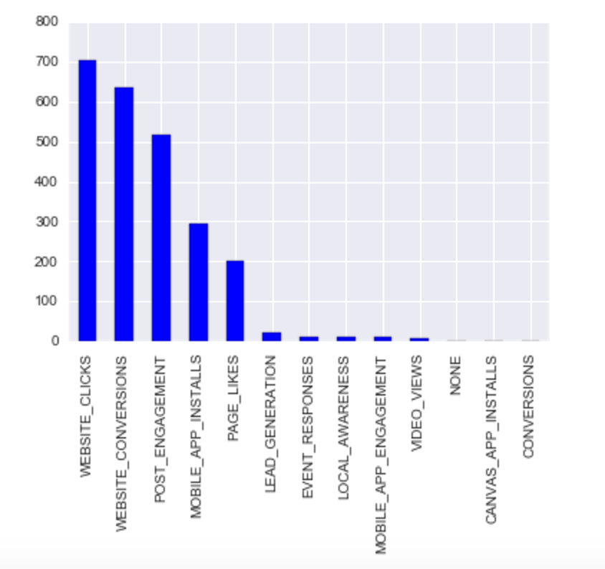
Campaign Data Collected from Facebook
Collected data for Campaigns from over than 500 advertisers Ad Accounts around the world
Resulted in 1200 Campaigns Total
Data belongs to campaigns running between July 2015 and April 2016
Campaigns Break down by campaign objective

Slide 8
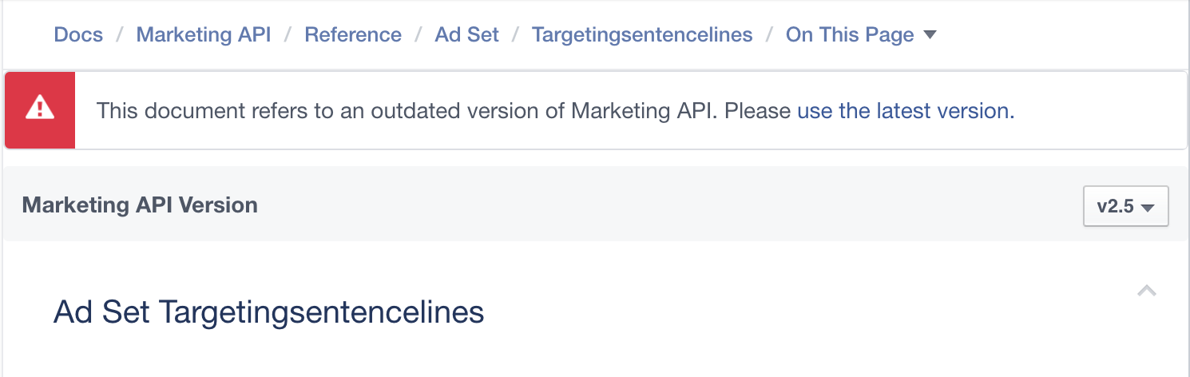
Data Limitations and Challenges
Data collected from facebook didn’t have the business category of the advertiser running the campaign attached
Data collected didn’t have the Targeting Information (targeting sentences)for every campaign since it was deprecated within the new v2.5 API
Data Had major outliers:
Conversions = 0, clicks = 0 …etc

Slide 9


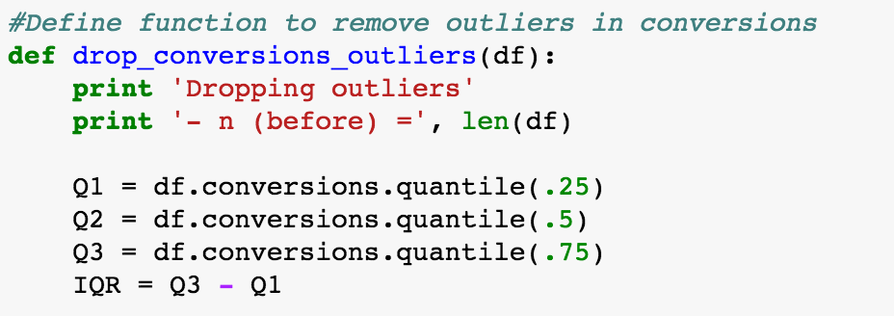
Data Cleaning 1/2
# Convert utc date/time into readable datatime object into a new column
Grouped campaigns data by date
Removed Outliers

Slide 10


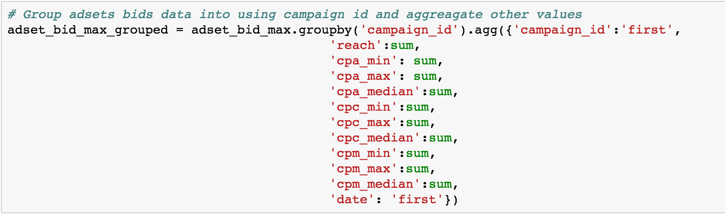
Data Cleaning 2/2
Merge Campaings data with Adsets and ads data
Apply Grouping on the campaign level

Slide 11
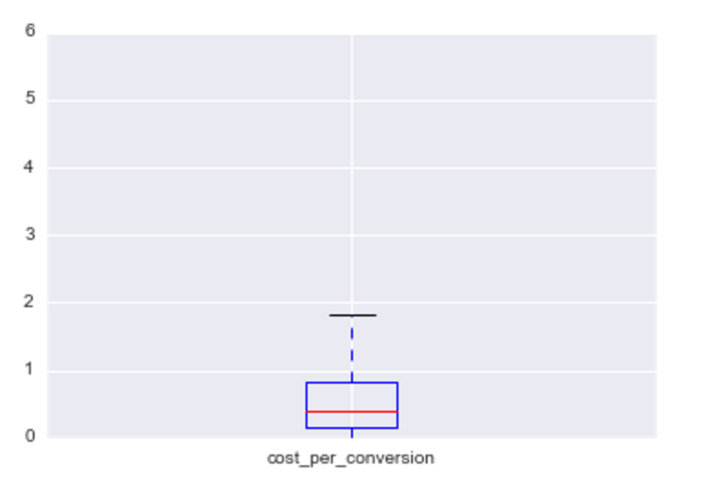
Cleaned Data
After removing outliers and bad data, we were left with 1,200 valid campaign data with the following characteristics:
Mean CP_Con markup: $0.75
Standard Deviation: 1.02
Min CP_Con : $0.003
Max CP_Con : $5.84

Slide 12
Features
Used the following campaign features to attempt to predict cost_per_conversion:
cpa_median: Cost per action Median
cpc_median: Cost per click Median
cpm_median: Cost per 1000 Impression Median
Spent: Spent per campaign
Objective: Campaign Objective
Objective_MOBILE_APP_INSTALLS
Objective_WEBSITE_CLICKS
Objective_WEBSITE_CONVERSIONS ….
BidStrategy
Automated
CPC
ocpm
maxBid_CPC
maxBid_ocpm

Slide 13
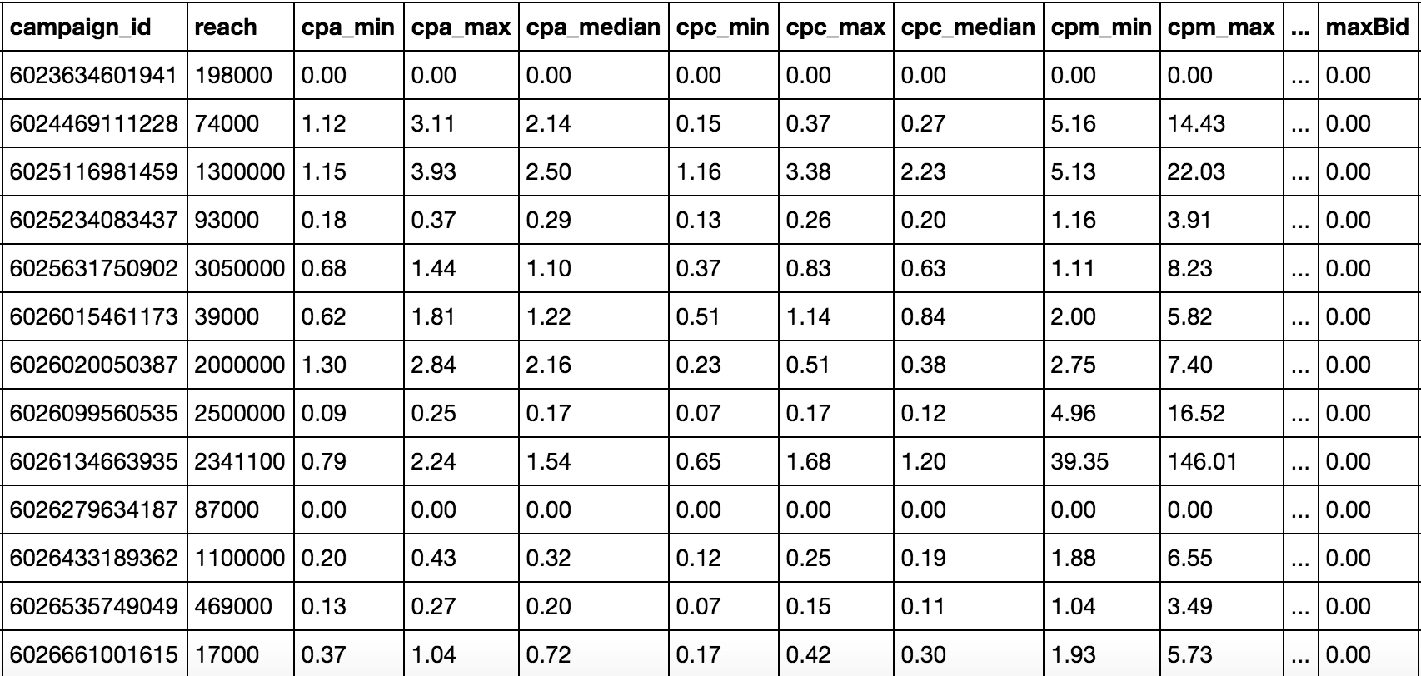
Data Frame Sample

Slide 14
Linear Regression
Used ols from statsmodels. Formula
Split data into training set (60%) and test set (30%)
Linear regression is prone to outliers, so let’s make sure we remove outliers

Slide 15
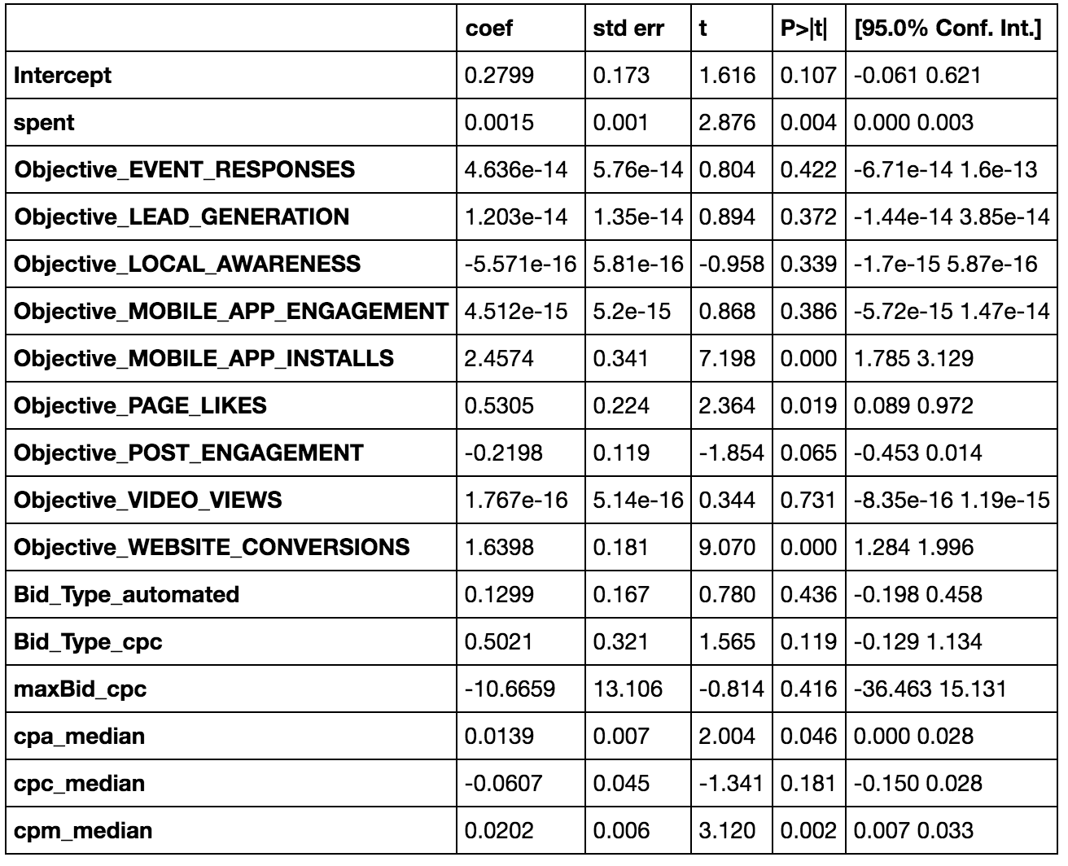
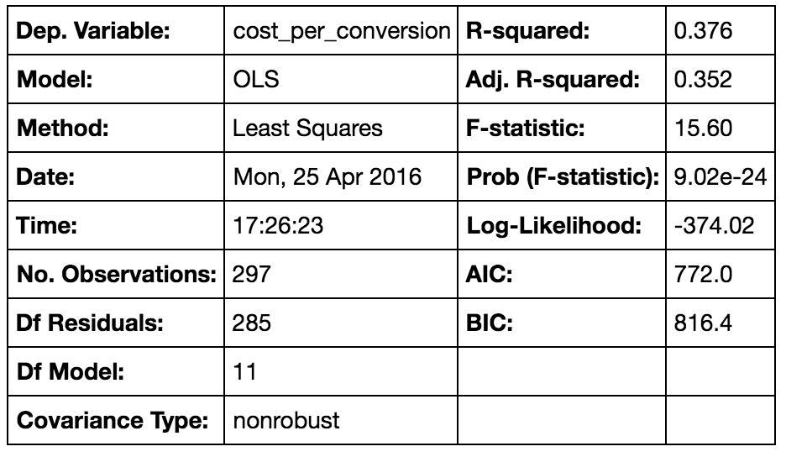
Linear Regression – Model 1
Used Linear Regression on all features at the beginning with to predict the cost per conversion for every campaign:
Used the Statsmodel python package to get p-values, R^2, and coefficients:
R^2 is low (~ 0.37)
Some coefficient P-values are significant!
Model may not capture much variability, but results are significant

Slide 16
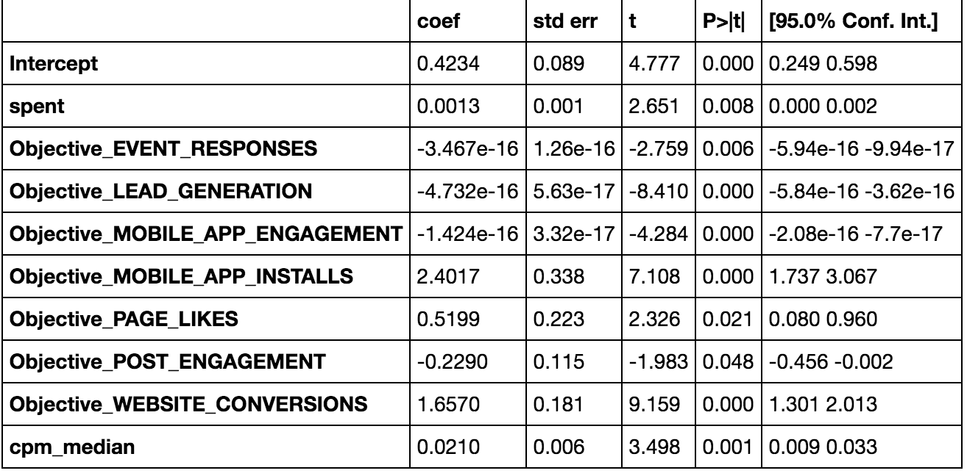
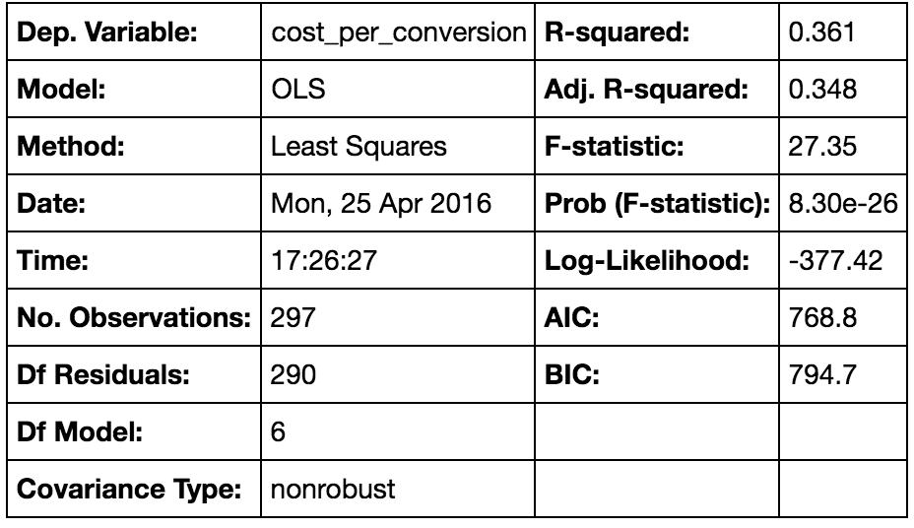
Linear Regression – Model 2
Used Linear Regression on all features with significant p-values only to predict the cost per conversion for every campaign:
Used the Statsmodel python package to get p-values, R^2, and coefficients:
R^2 is low (~ 0.36)
coefficient P-values are significant!
Model may not capture much variability, but results are significant.

Slide 17
Linear Regression – Model 3
R-squared will always increase as you add more features to the model
Even if they are unrelated to the response. Thus, selecting the model with the highest R-squared is not a reliable approach for choosing the best linear model.
So we use Cross-validation. It provides a more reliable estimate of out-of-sample error, and thus is a better way to choose which of your models will best generalize to out-of-sample data.

Slide 18
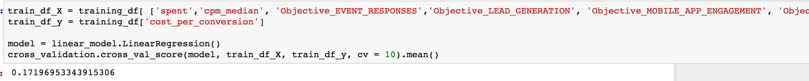
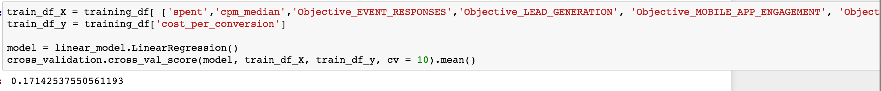
Linear Regression – Model 4
We used scikit-learn with K=10 Fold cross validation
We have used cross validation to compare between models and choose the model with the best cross validation value. Once we discover that we need to create a final model and then predict using it.

Slide 19
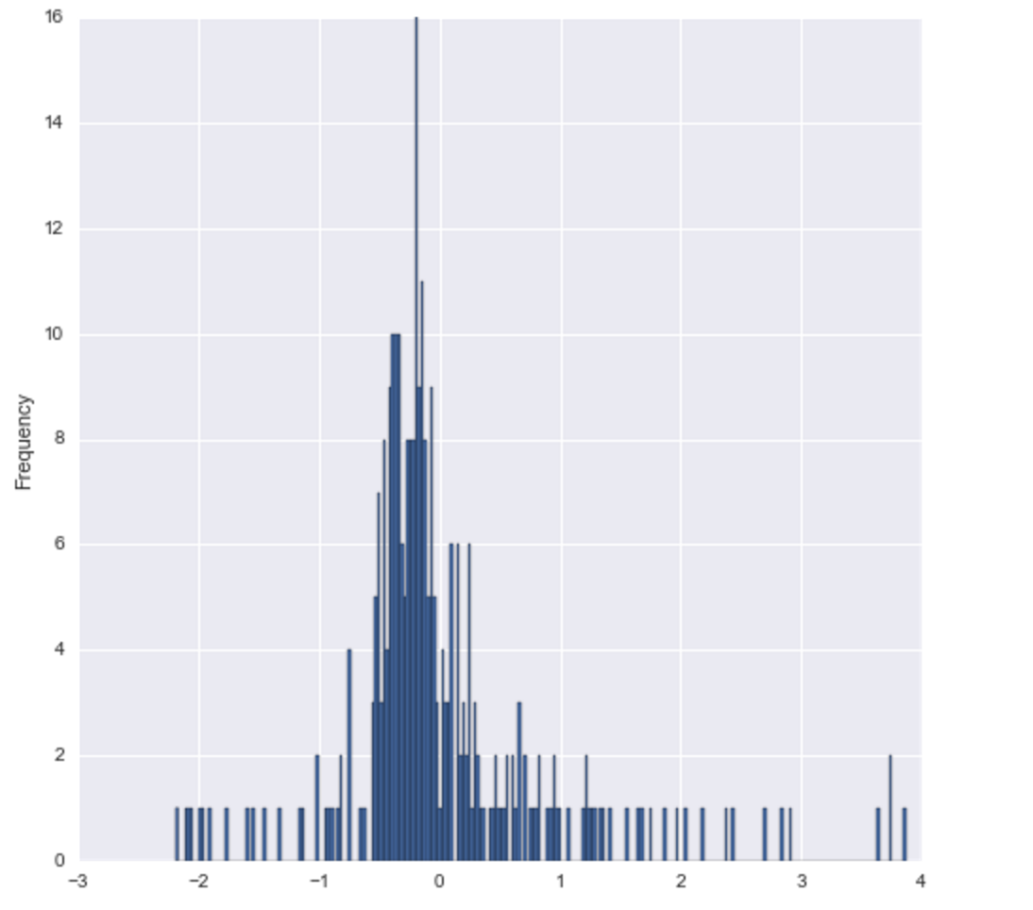
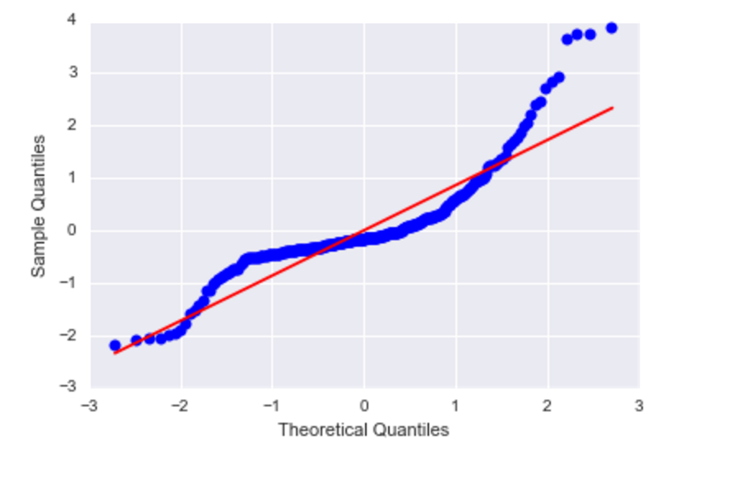
Normality assumption – Histogram/q-q Plot

Slide 20
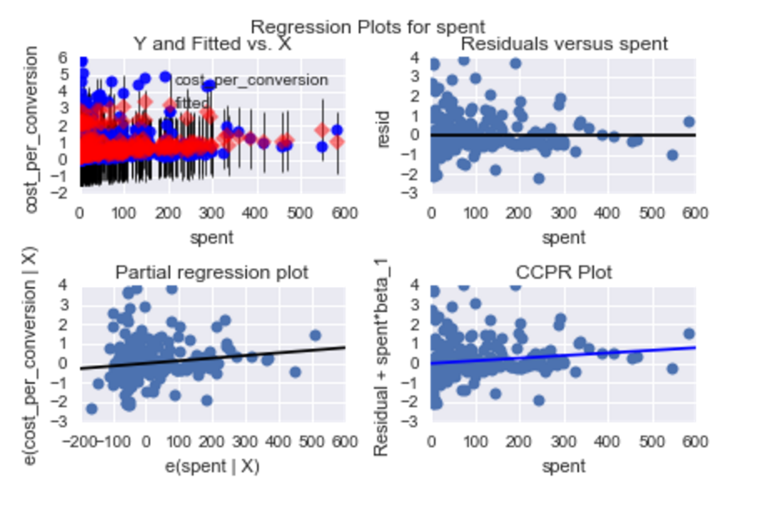
Checking modeling assumptions

Slide 21
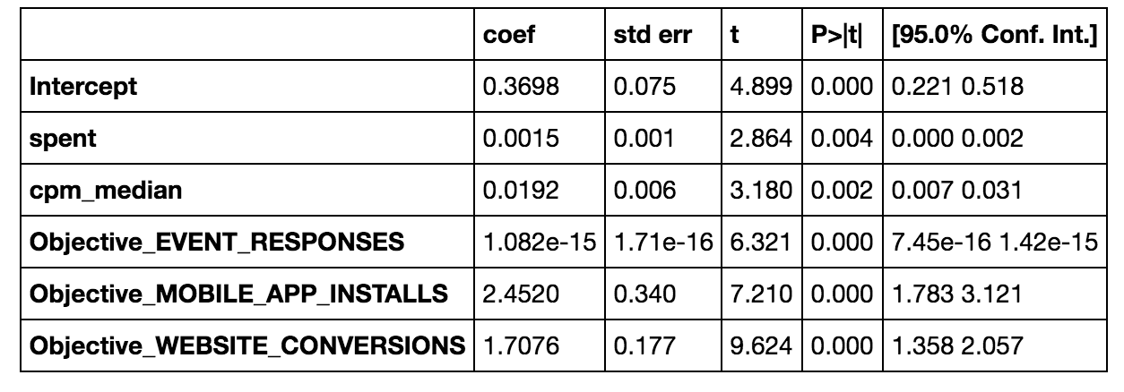
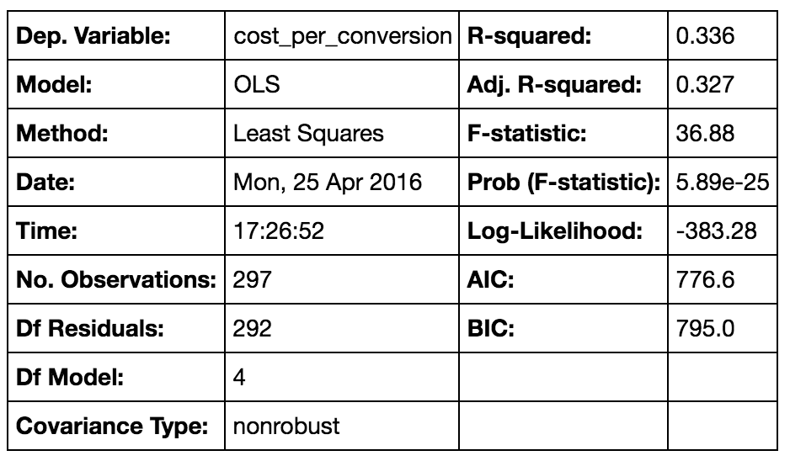
Linear Regression – Final Model

Slide 22
Interpreting Linear Regression Result
Spent coefficient is 0.0015 ○ Spent = how much the actual spent over the campaign life-cycle
Cpm_median coefficient is 0.02
Interpretation: holding all other variables fixed...
For every increase of 0.1 in spent metric, the campaign cost per conversion increases by $0.0015
For every increase of 0.1 in cost per impression, the campaign cost per conversion increases by $0.02

Slide 23
Linear Model Limitation
Interpretation from Linear Regression is based on the assumption that the data is linear
This may not be true - low R^2 value suggests that linear model doesn’t capture much variability
Did not include some variables that may explain additional variability
Targeting Info for every campaign (Demographics, interests,GeoLocation..etc)
Business Category for every advertiser (Food, Homes, …etc )

Slide 24
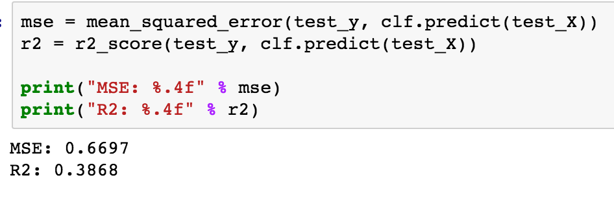
Random Forest Regressor + Gradient Boosting Regressor
RandomForestRegressor yielded best results with max_features value of 4
cross_validation.cross_val_score(model, train_X, train_y, cv = 10).mean()
0.175
Regressor made correct predictions ~17.5% of the time
Let’s try Boosting
Ideal parameters for GradientBoostingClassifier:
Number of trees: 500
Max depth: 6
Loss : huber
Alpha: 0.95
The Mean Squared Error wasn’t much informative and used instead the R2 coefficient of determination.
This measure is a number indicating how well a variable is able to predict the other. Values close to 0 means poor prediction and values close to 1 means perfect prediction. within our model we got 0.38.
Better than nothing, but still not great

Slide 25
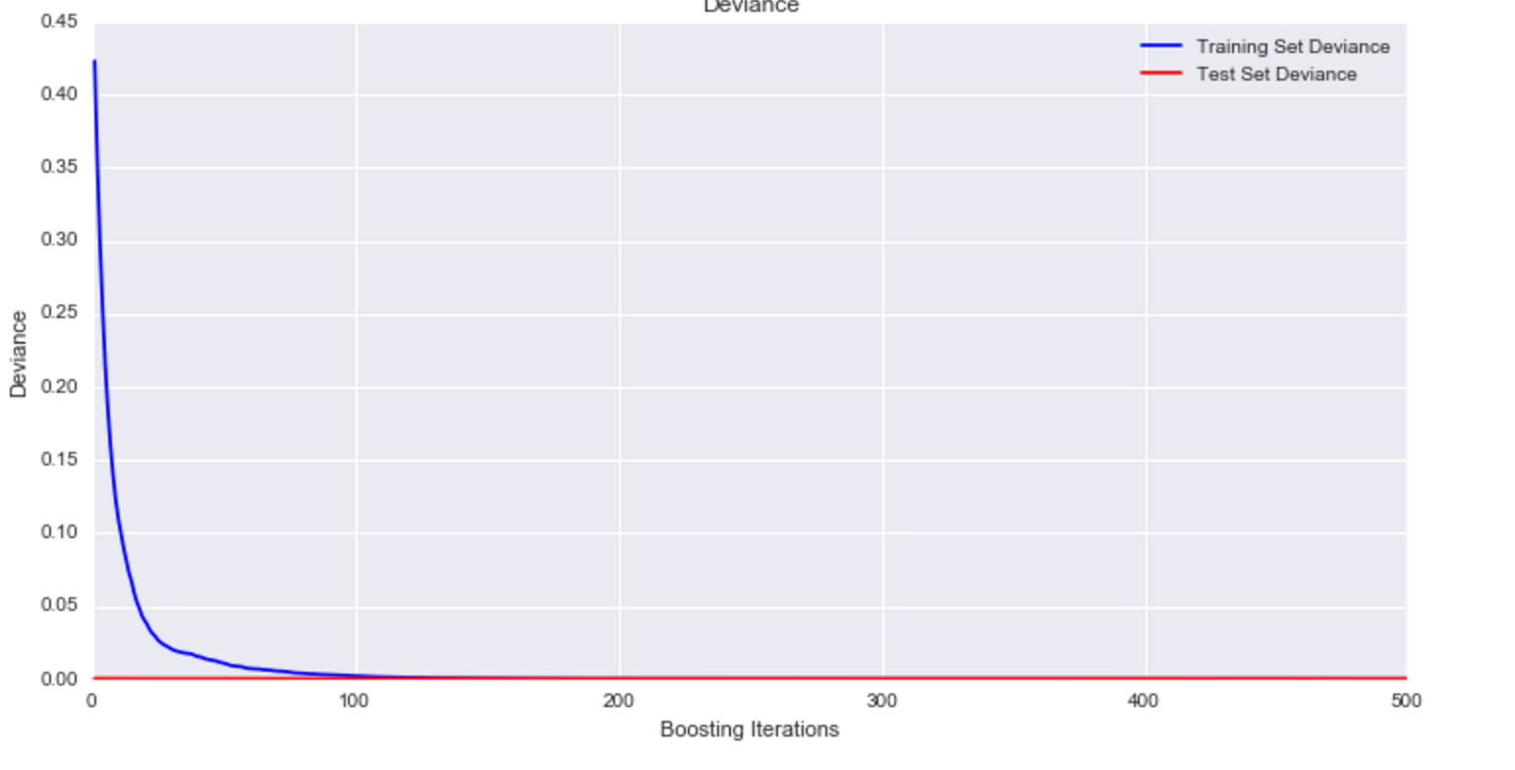
Gradient Boosting Regressor
As you can see in the graph, although the train error keeps going down as we add more trees to our model, the test error remains more or less constant and doesn’t incur in overfitting. This is mainly due to the shrinkage parameter and one of the good features of this algorithm.

Slide 26
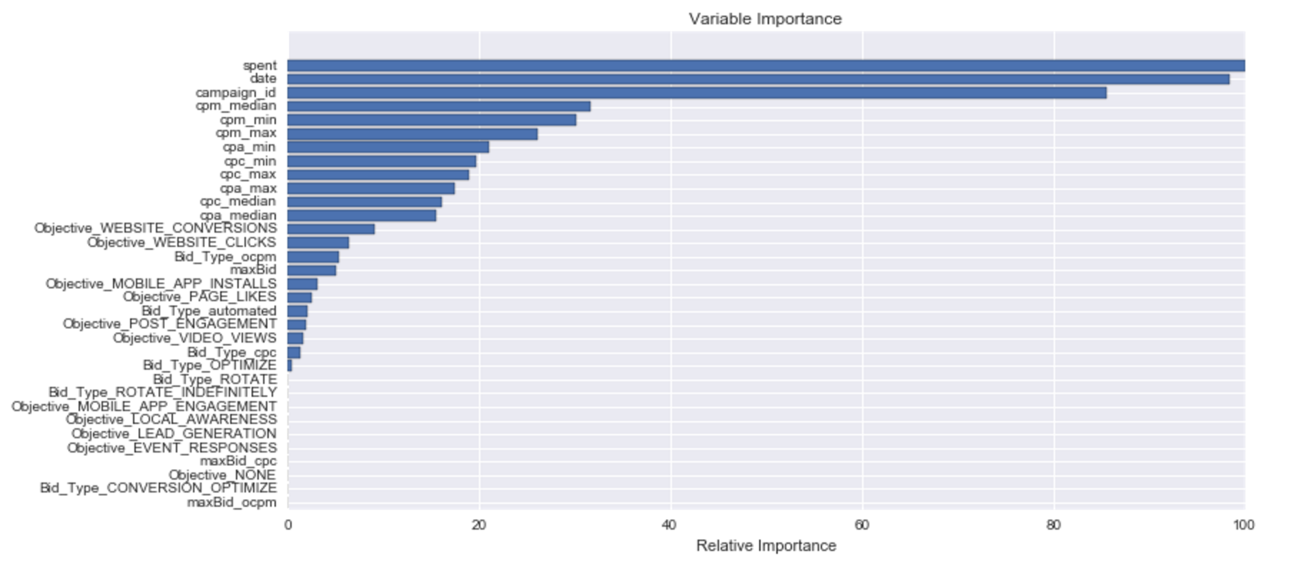
Gradient Boosting Regressor
Although base trees are easily interpretable when you are adding several of those trees interpretation is more difficult. You usually rely on some measures of the predictive power of each feature. Let’s plot feature importance in predicting the cost_per_conversion Value.

Slide 27
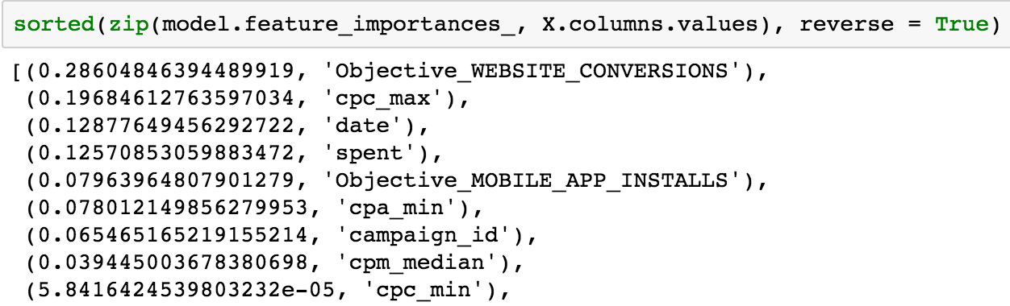
Regression Decision Trees
Used DecisionTreeRegressor from sklearn. tree
Split data into training set (60%) and test set (30%)
Tuned model and found best results with 4 max_depth
Model with these parameters produced MSE of ~0.913 when run with test data
This MSE means, how much the model’s prediction was off on average when run on test data

Slide 28
Data Limitations
Only looked at median of cpm, cpc, cpa to compute cost_per_conversion
Data came from ~ 500 advertisers, so conclusions are limited to campaigns running within their ads accounts.
Had to aggreagate Ad data, Adset data to compute Campaings data

Slide 29
Future Steps
Would like to gather more data from different sources, agencies.
Tackle the problem as a time series problem to figure out how the a campaign performance could evolve over time.
Expand the model to add other social media platforms to test my models cross channels including:
Help Advertisers pick up their best ad dollar platform depending on campaign objectives and

